Slide 1

Task 3
Data Insights and Presentation

Slide 2

Visualization by using Tableau

Slide 3
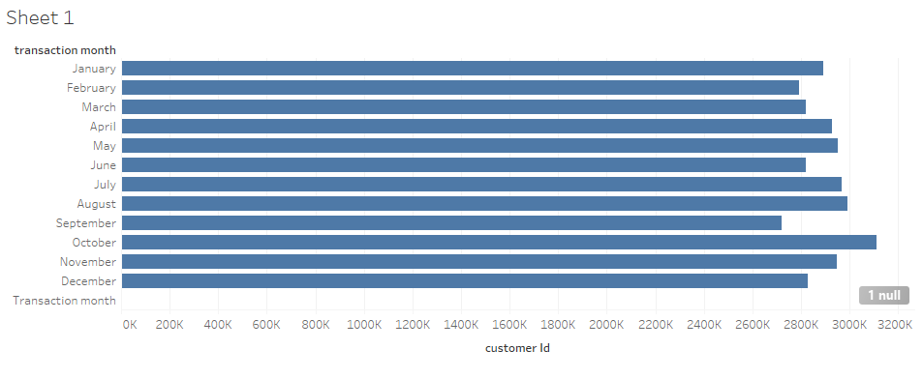
Transaction Vs Customer I’d

Slide 4
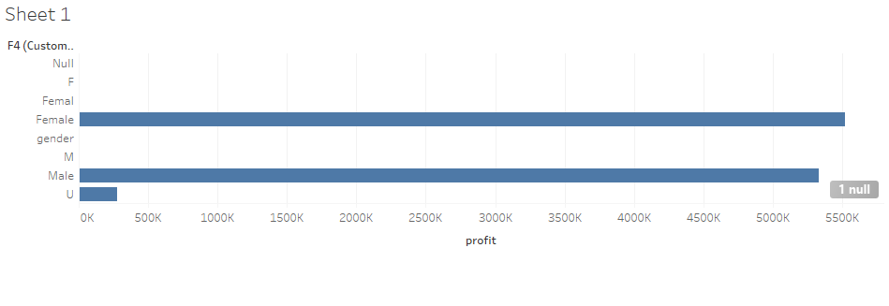
Gender Vs Profit

